Slide 1

OLIST E-COMMERCE
Sales Performance Dashboard
An interactive Power BI walkthrough — revenue, customers, products, and delivery performance, 2017–2018
Prepared as a project walkthrough | Power Query · Data Modeling · DAX · Visualization

Slide 2
Purpose
A single-page Power BI dashboard analyzing Olist's e-commerce performance — covering revenue, customers, products, and delivery — fully filterable in real time.
Who it's for
What it answers
How it's built
Sales & ops leaders who need a fast, no-query view of business health.
Where does revenue come from? Who are our best customers? Are deliveries on time?
Cleaned in Power Query, modeled with relationships, driven by 17 DAX measures.
2

Slide 3
Data & Modeling
From raw spreadsheet to a clean, connected model
1
→
2
→
3
→
4
Load
Clean
Relate
Measure
Imported the source workbook into Power Query for cleaning before it touched the model.
Fixed data types, formatted text (e.g. computers_accessories → Computers Accessories), parsed dates.
Built a relational model on order_id, connecting orders, payments, and delivery data.
Authored 17 DAX measures — revenue, customer, and delivery metrics — in a dedicated table.
3

Slide 4
17 DAX Measures, 3 Categories
Every KPI card and chart on the dashboard is powered by one of these
Sales & Revenue
Customers
Delivery & Fulfillment
Total Revenue
Total Orders
Average Order Value
Total Freight
Total Quantity
Distinct Customers
VIP Revenue & VIP Revenue %
Avg Recency (Days)
Repeat Customers
Repeat Customer Rate
Avg Delivery Days
On Time Orders
On Time Delivery Rate
Avg Review Score
Cancellation Rate
4

Slide 5
Dashboard Anatomy — Filters & KPIs
Five Headline KPIs
Filter Panel
1K
$256.8K
$256.8
3.65
61%
Order Date range
Customer State
Customer City
Payment Type
Order Status
One-click Reset Filter button
Total Orders
Total Revenue
Avg Order Value
Avg Review Score
On-Time Delivery
These five metrics give an at-a-glance read on order volume, revenue, spend per order, customer satisfaction, and delivery reliability — the core health signals of the business.
Design note
Every visual on the page responds instantly to these selections.
Each card uses a distinct pastel color for quick visual scanning — a deliberate departure from Power BI's default single-tone cards.
5

Slide 6
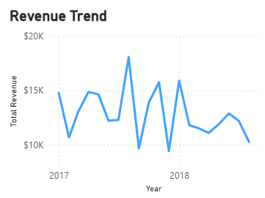
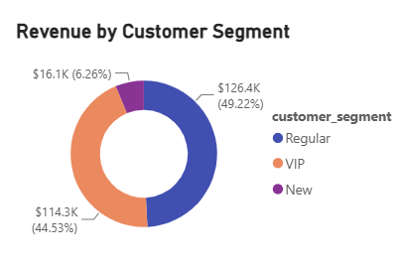
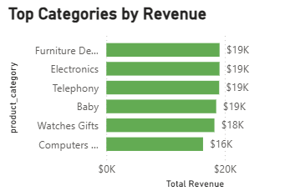
Chart Walkthrough — Revenue Story
Revenue Trend
Revenue by Customer Segment
Top Categories by Revenue
Line chart · monthly, 2017–2018
Donut · Regular / VIP / New
Bar chart · top 6 categories
Tracks month-over-month revenue to reveal growth patterns and seasonality across the two-year window.
Regular customers drive the largest share of revenue (≈49%), ahead of New (≈45%) and VIP (≈6%).
Ranks product categories by revenue — Bed, Bath & Table leads at roughly $23K.
6

Slide 7
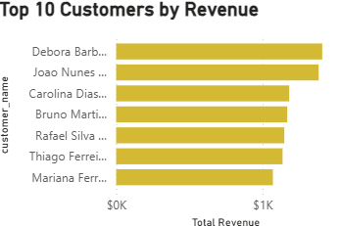
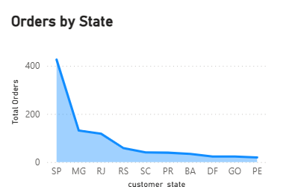
Chart Walkthrough — Customers
Top 10 Customers by Revenue
Orders by State
Horizontal bar chart
Area chart · customer state
Surfaces the highest-value individual customers — a direct shortlist for retention or loyalty outreach.
Order volume is heavily concentrated in one state (SP), dropping off sharply elsewhere — a geographic concentration risk and opportunity.
7

Slide 8
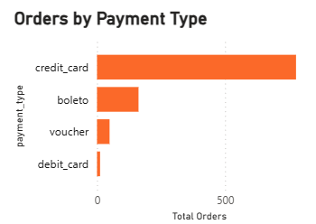
Chart Walkthrough — Operations
Orders by Payment Type
What this shows
Bar chart · payment method
Credit card is the dominant payment method by a wide margin, ahead of boleto, voucher, and debit card.
Why it matters
Checkout flow and fraud checks should be optimized around card payments first, with boleto as the key secondary path.
8

Slide 9
Why This Matters?
What this dashboard lets a decision-maker do
Spot growth & seasonality
Prioritize the right customers
1
2
Monthly revenue trend flags upswings and dips worth investigating.
Segment and top-customer views point straight to retention targets.
Watch delivery risk
Act on geography & payment mix
3
4
On-time rate and cancellation rate expose fulfillment problems early.
State concentration and payment preferences inform logistics and checkout decisions.
9

Slide 10
Thank You
Questions & discussion welcome
Built with Power Query · Data Modeling · DAX · Power BI Desktop

